Slide 1
TITLE
Project Name: Home Automation via Bluetooth using ESP32
Name: T.Amulya
Intern ID: CITS3856
Duration: 4 weeks

Slide 2
ABSTRACT
The Home Automation via Bluetooth using ESP32 is an embedded systems project that enables wireless control of household appliances through Bluetooth communication. In this project, LEDs are used to represent home appliances such as room lights, bed lamps, fans, and power sockets. The ESP32 receives commands from the user and controls the connected devices accordingly. Since Wokwi does not support Bluetooth simulation directly, the Serial Monitor is used as a virtual Bluetooth terminal. This project demonstrates the concept of wireless home automation and the application of embedded systems in smart homes. The user can control electrical devices such as LEDs using a smartphone through Bluetooth commands. The system provides a simple, wireless, and low-cost solution for smart home applications.

Slide 3
INTRODUCTION
Home automation is one of the most important applications of embedded systems and IoT technology. It allows users to monitor and control electrical appliances remotely, reducing human effort and increasing convenience. Bluetooth technology provides a low-cost and energy-efficient method for wireless communication between devices. The ESP32 microcontroller contains built-in Bluetooth and Wi-Fi capabilities, making it suitable for smart home applications. This project demonstrates how Bluetooth communication can be used to control home appliances represented by LEDs. Home automation enables users to control household devices remotely. This improves convenience and energy efficiency.

Slide 4
OBJECTIVES
To understand the concept of home automation.
To develop a Bluetooth-controlled appliance system using ESP32.
To simulate wireless communication using the Serial Monitor.
To control multiple devices through command-based communication.
To gain practical knowledge of embedded system programming.
To understand embedded system applications.
To Provide a simple and low-cost solution.

Slide 5
COMPONENTS USED
Hardware Components:
ESP32 Development Board
LED
220Ω Resistor
Jumper Wires
Software Components:
Arduino IDE
Wokwi Simulator
Bluetooth Terminal App

Slide 6
METHODOLOGY
Initialize ESP32 and Bluetooth communication.
Pair the smartphone with the ESP32 device.
Send commands through a Bluetooth apllications.
ESP32 receives the commands and processes them.
The LED turns ON when command ‘1’ is received.
The LED turns OFF when command ‘0’ is recieved.
Thw system provides wireless control of home appliances.

Slide 7
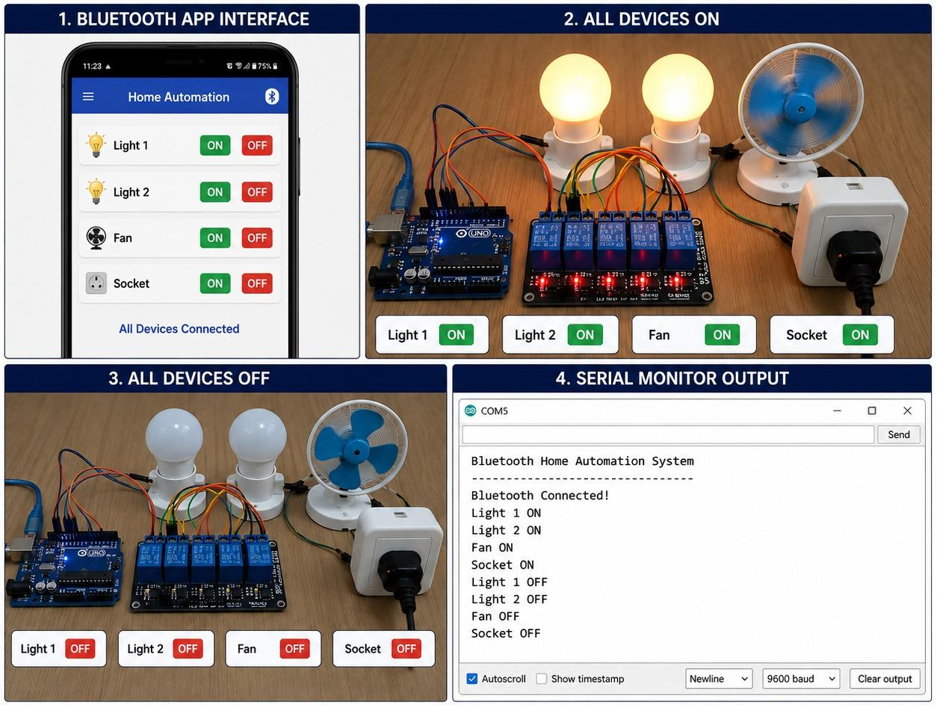
EXPECTED RESULT
The system successfully controls four appliances using command-based communication. Each appliance responds correctly to the corresponding command. The Serial Monitor displays the appliance status, and the LEDs indicate the output state in real time.

Slide 8
ADVANTAGES
Wireless Operation.
Easy to Implement.
Low cost.
Energy efficient.
Compact and reliable.
Expandable for IoT Applications

Slide 9
APPLICATIONS
Smart Homes.
Lighting Control systems.
Fan and appliance control.
Industrial automation.
Security system.
IoT based applications.
Educational Embedded System Projects
Wireless Device Management

Slide 10
CONCLUSION
The Home Automation via Bluetooth using ESP32 project successfully demonstrates wireless appliance control using embedded system technology. The system provides a simple and cost-effective automation solution and serves as a foundation for advanced smart home and IoT applications. It Provides an efficient way to control appliances remotely and can be extended for IoT based automation systems in the future.

